Slide 1
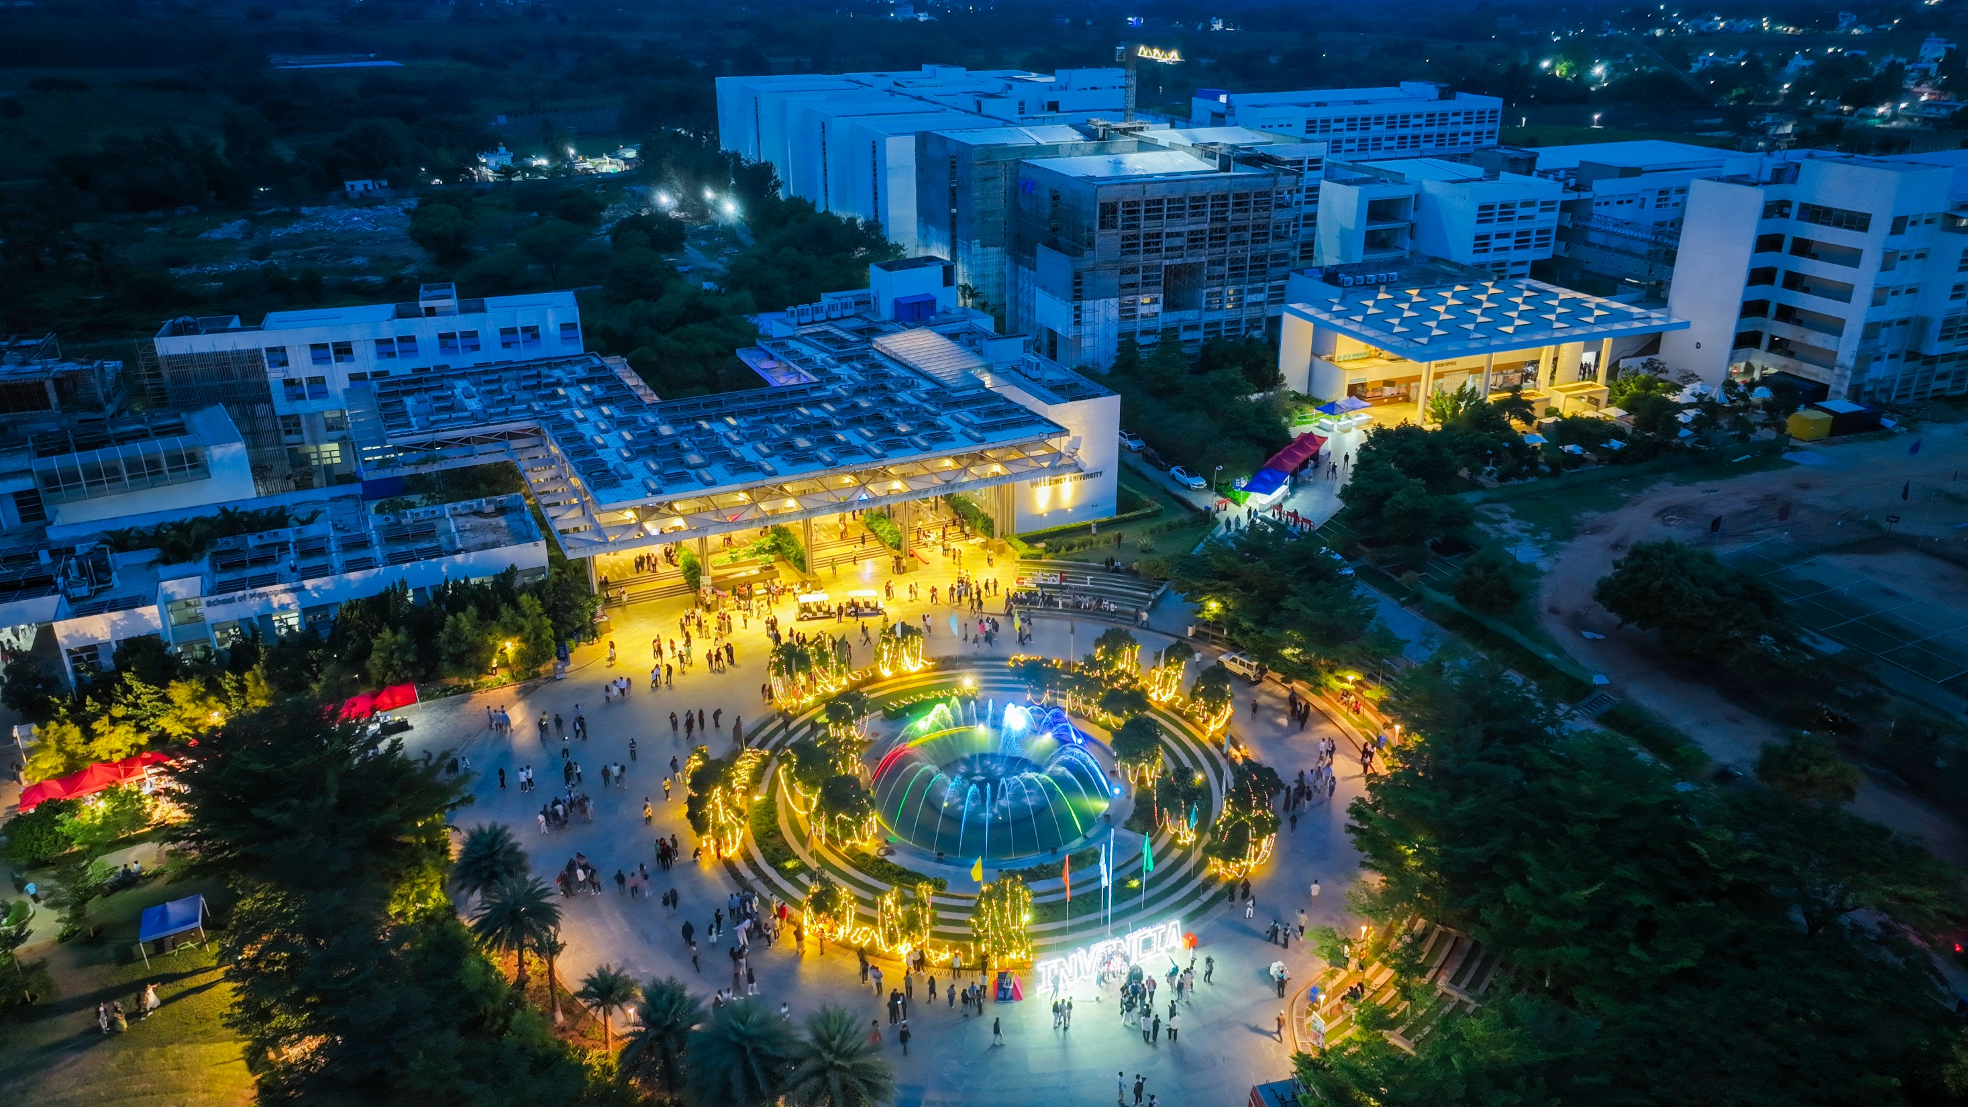

Presidency
Presidency
School of Artificial Intelligence and Advanced Computing

Slide 2
AUTONOMOUS AI AGENT FOR IT HELPDESK
CSS7102- Mini Project Review-2
Batch Number:CAI_27
Under the Supervision of,
Mr. Parth Naik
Assistant Professor
School of Computer Science and Engineering
Presidency University
Roll Number | Student Name
20221CAI0154 | VISHNU PRASAD GOTUR
20231CAI0139 | SHIVARAJ
Name of the Program: B.Tech Computer Science and Engineering (Artificial Intelligence & Machine Learning)
Name of the HoD: Dr. Zafar Ali Khan
Name of the Program Project Coordinator: Ms. Suma N G
Name of the School Project Coordinators: Dr. Sampath A K

Slide 3
Content
1. Abstract
2. Literature Survey
3. Objectives
4. Existing Methods & Drawbacks
5. Proposed Method & Feasibility Study
6. Architecture Diagram
7. Modules
8. Hardware & Software Details
9. Timeline (Gantt Chart)
10. References

Slide 4
ABSTRACT
The proposed project develops an Autonomous AI Agent for IT Helpdesk to handle suitable repetitive Level-1 IT support requests, such as password resets, software installation, and access requests.
The system combines natural-language request understanding, Enterprise Knowledge Retrieval (RAG), LLM reasoning and planning, controlled workflow execution, outcome verification, and human escalation.
The proposed model introduces policy and authorization controls before tool execution, while verification compares the expected and actual IT state to determine whether the request can be resolved, re-planned, or escalated.

Slide 5
LITERATURE SURVEY
No. | Research Paper / Focus | Contribution & Limitation
1 | Firmansyah & Subriadi (2022) — IT Service Desk Model | Establishes IT service-desk foundation; does not provide an autonomous LLM-agent pipeline.
2 | Jäntti & Kalliokoski (2010) — Service Desk Knowledge Management | Highlights knowledge-management challenges; does not address autonomous agent execution.
3 | Tello, Ruiz & Yoo (2018) — COBIT 5 DSS02 / Process Mining | Provides structured service-request and incident workflow; no LLM-based execution.
4 | Nascimento, Alencar & Cowan (2023) — Self-Adaptive LLM Multiagent Systems | Supports adaptive LLM-agent architecture; broader than IT helpdesk automation.
5 | Zhang et al. (2024) — PrivacyAsst | Addresses privacy and controlled tool use; does not cover the complete helpdesk lifecycle.

Slide 6
LITERATURE SURVEY
6 | SIMA 2 (2025) — Generalist Embodied Agent | Demonstrates goal-directed agent behaviour; different domain from IT helpdesk.
7 | Evolving Deeper LLM Thinking (2025) | Supports inference-time reasoning and iterative refinement; not IT-helpdesk specific.
8 | Richens & Everitt (2024) — Causal World Models | Provides causal world-model foundation; not an IT-helpdesk resolution system.
9 | BrowseComp (2025) — Browsing Agents | Supports agentic information gathering; does not provide controlled IT workflow execution.
10 | How Agents Are Transforming Work (OpenAI) | Provides enterprise-work context for delegated agents; does not define the proposed controlled IT-helpdesk architecture.
Existing research provides strong individual building blocks for ITSM, knowledge retrieval, autonomous agents, reasoning and tool use. However, these capabilities are not integrated into one controlled Level-1 IT helpdesk pipeline with policy enforcement, authorization, verification and human escalation.
Proposed Direction:
Request Understanding → Knowledge Retrieval → IT State → Reasoning & Planning → Policy → Controlled Execution → Verification → Escalation

Slide 7
OBJECTIVES
1. Understand and classify natural-language Level-1 IT helpdesk requests.
2. Retrieve relevant enterprise knowledge using Retrieval-Augmented Generation (RAG).
3. Represent relevant IT state using an IT State / World Model.
4. Reason and plan suitable resolution actions using an LLM.
5. Evaluate candidate plans before execution.
6. Apply policy, authorization and risk checks before executing actions.
7. Select and execute authorized workflows through controlled tools/APIs.
8. Observe and verify the expected outcome against the actual IT state.
9. Resolve, re-plan or escalate requests based on verification and safety conditions.
10. Define measurable evaluation criteria for system performance.

Slide 8
EXISTING METHODS & DRAWBACKS
Existing Approach | What It Provides | Key Drawback
Rule / Process-Based Helpdesk | Repeatable predefined workflows | Rigid for varied natural-language requests
ML-Based Helpdesk | Ticket classification and prediction | Does not provide autonomous multi-step resolution
Knowledge / RAG Systems | Knowledge grounding and information retrieval | Retrieval alone does not decide or execute actions
LLM-Based Agents | Reasoning, planning and action capabilities | Hallucination, authorization, privacy and tool-use risks
Tool-Using Agents | Interaction with external tools/APIs | Require policy, least privilege, verification and human escalation

Slide 9
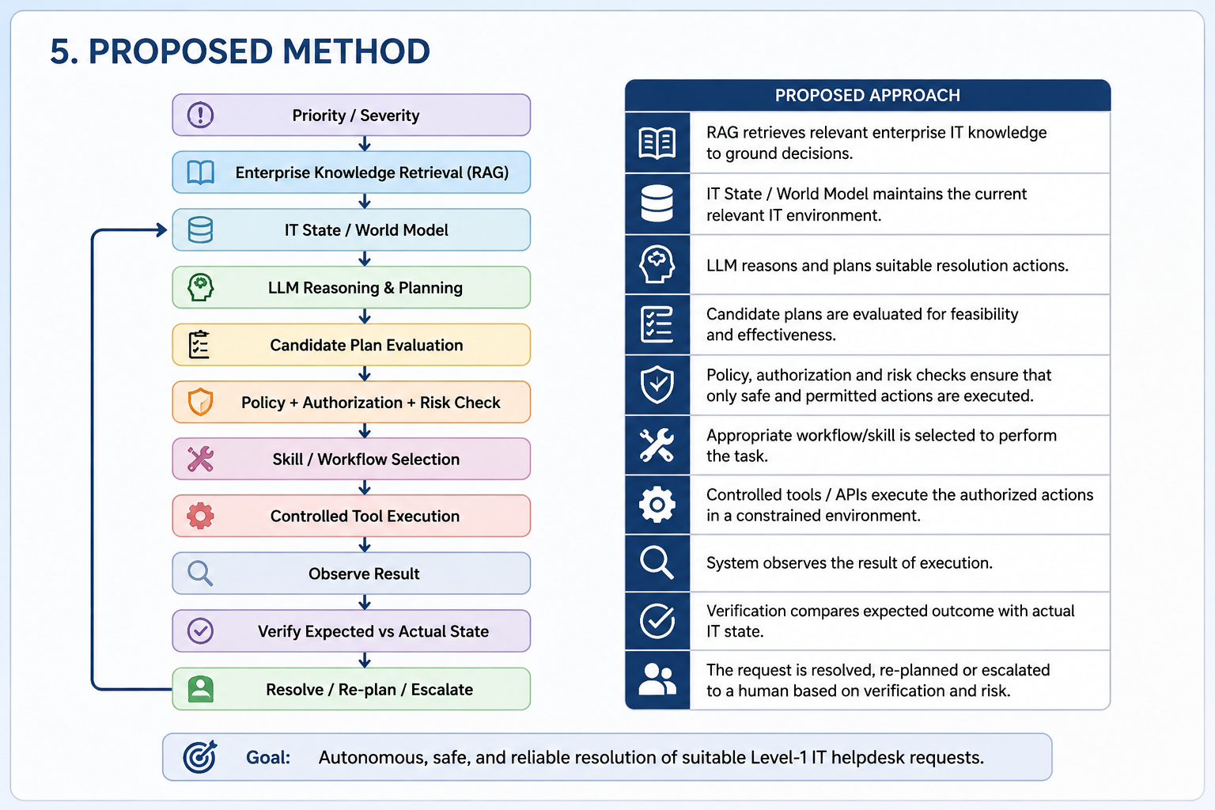
PROPOSED METHODOLOGY

Slide 10
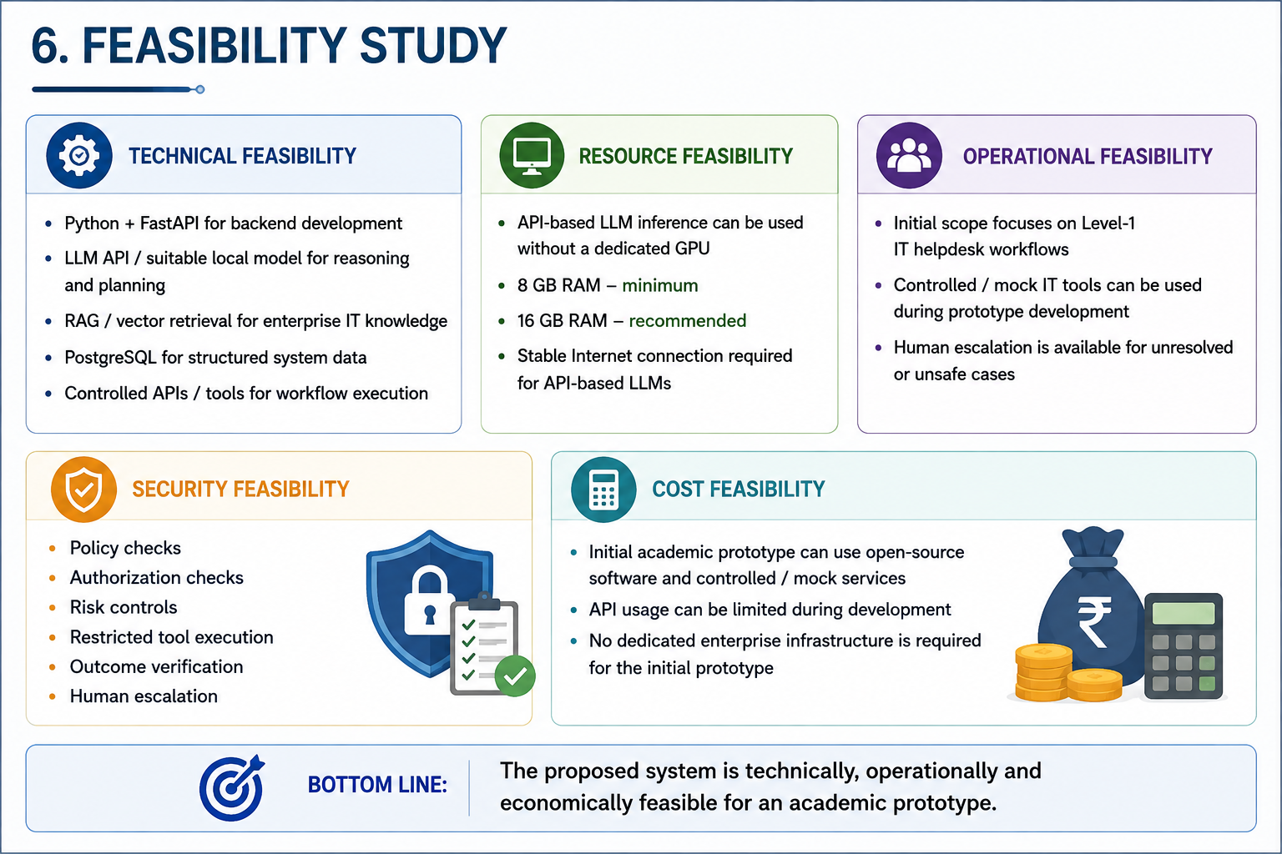
FEASIBILITY STUDY

Slide 11
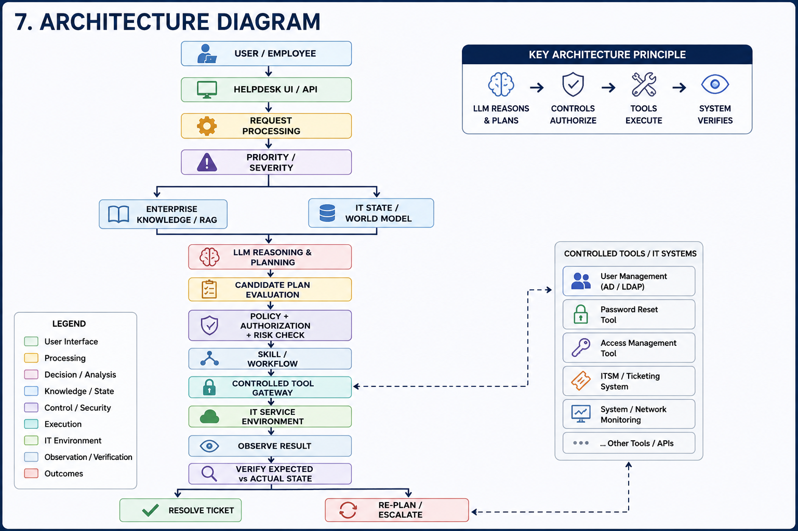

Slide 12
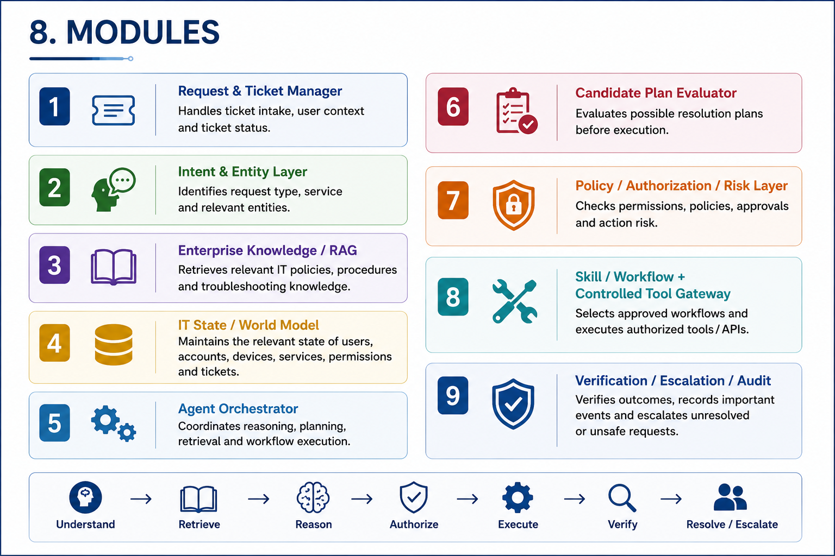

Slide 13
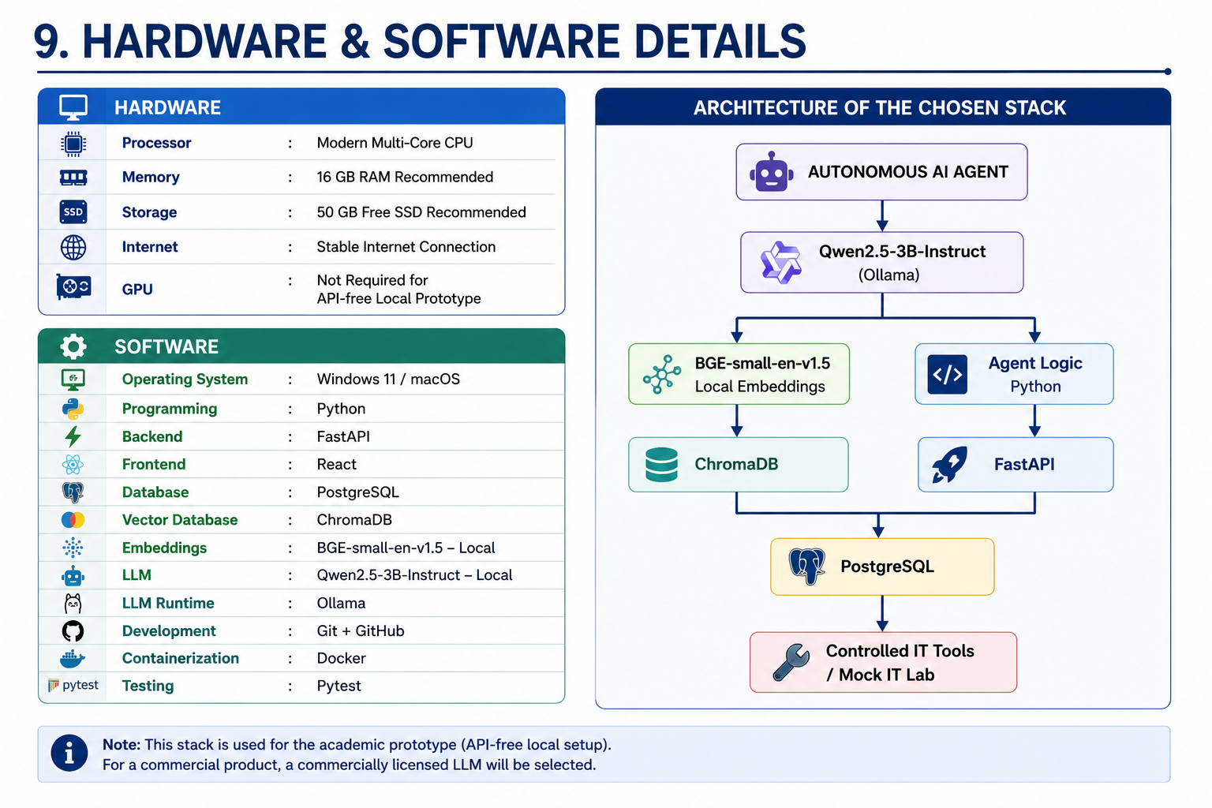

Slide 14
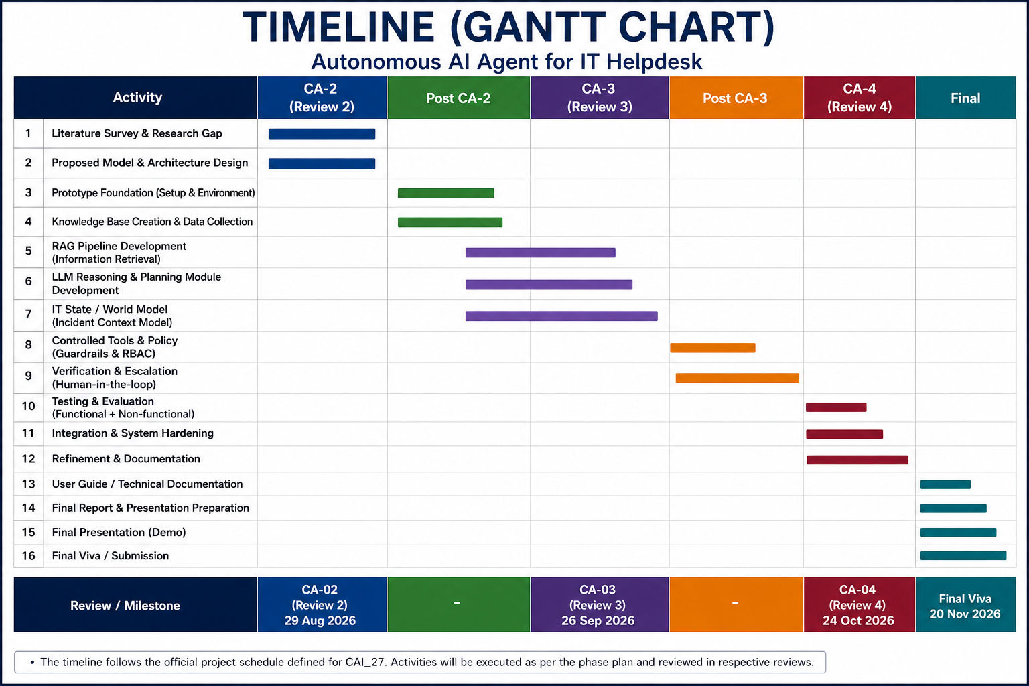

Slide 15
References (IEEE Paper format)
[1] A. D. Firmansyah and A. P. Subriadi, “IT Service Desk Model Literature Review: Benefits and Challenges,” in 2022 International Seminar on Application for Technology of Information and Communication (iSemantic), 2022, pp. 172–177,
doi: 10.1109/iSemantic55962.2022.9920439.
[2] M. Jäntti and J. Kalliokoski, “Identifying Knowledge Management Challenges in a Service Desk: A Case Study,” in 2010 Second International Conference on Information, Process, and Knowledge Management (eKNOW), 2010,
doi: 10.1109/eKNOW.2010.20.
[3] I. Tello, C. Ruiz, and S. G. Yoo, “Analysis of COBIT 5 Process ‘DSS02 - Manage Service Requests and Incidents’ for the Service Desk Using Process Mining,” in 2018 Fifth International Conference on eDemocracy & eGovernment (ICEDEG), 2018, pp. 304–310,
doi: 10.1109/ICEDEG.2018.8372335.
[4] N. Nascimento, P. Alencar, and D. Cowan, “Self-Adaptive Large Language Model (LLM)-Based Multiagent Systems,” in 2023 IEEE International Conference on Autonomic Computing and Self-Organizing Systems Companion (ACSOS-C),2023, pp. 104–109,
doi: 10.1109/ACSOS-C58168.2023.00048.
[5] X. Zhang, H. Xu, Z. Ba, Z. Wang, Y. Hong, J. Liu, Z. Qin, and K. Ren, “PrivacyAsst: Safeguarding User Privacy in Tool-Using Large Language Model Agents,” IEEE Transactions on Dependable and Secure Computing, vol. 21,no. 6, pp. 5242–5258, 2024,
doi: 10.1109/TDSC.2024.3372777.
[6] SIMA Team, “SIMA 2: A Generalist Embodied Agent for Virtual Worlds,” arXiv:2512.04797, 2025,
doi: 10.48550/arXiv.2512.04797.
[7] K.-H. Lee, I. Fischer, Y.-H. Wu, D. Marwood, S. Baluja, D. Schuurmans, and X. Chen, “Evolving Deeper LLM Thinking,” arXiv:2501.09891, 2025,
doi: 10.48550/arXiv.2501.09891.
[8] J. Richens and T. Everitt, “Robust Agents Learn Causal World Models,” in International Conference on Learning Representations (ICLR), 2024.
[9] J. Wei, Z. Sun, S. Papay, S. McKinney, J. Han, I. Fulford, H. W. Chung, A. T. Passos, W. Fedus, and A. Glaese, “BrowseComp: A Simple Yet Challenging
Benchmark for Browsing Agents,” arXiv:2504.12516, 2025,
doi: 10.48550/arXiv.2504.12516.
[10] OpenAI, “How Agents Are Transforming Work,” OpenAI Economic Research, Jun. 25, 2026.

Slide 16


